Slide 1

Group 3
Alessandro Barbero 10536528
Luca Cattaneo 10521219
Mara Pegoraro 10629697
Jacopo Elia Pometto 10521596
Giovanni Valtorta 10528573
Energy And emissions Project
«Local refilling infrastructure for hydrogen or electrical HD fleets»

Slide 2
Current situation
Average number of HD vehicles in Europe 11,608,785 (2.92% of total motor vehicles)
Average age of the fleet 13 years (ACEA, 2019)
Predominance of diesel powered vehicles Necessity to switch to greener energy sources

Slide 3
Share of fuels used by HD transport
Source: Report – Vehicles in use, Europe 2021 (ACEA)

Slide 4
How to solve this issue?
Reduce the share of fossil fuels in this sector.
FUEL | PROS | CONS
Biofuels | Derivable from waste products | Still emits CO₂ during use
Electricity | 100% clean during use Possibility to couple the vehicle with a fixed infrastructure (OVH contact line) | Cleanness depends on energetic Charging infrastructure and time Weight of the battery
Hydrogen | 100% clean during use Higher energy density | Lower volumetric density

Slide 5
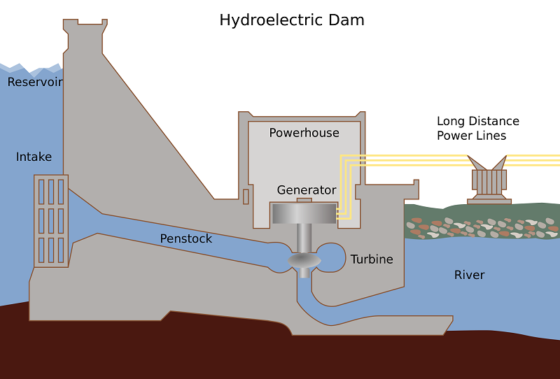
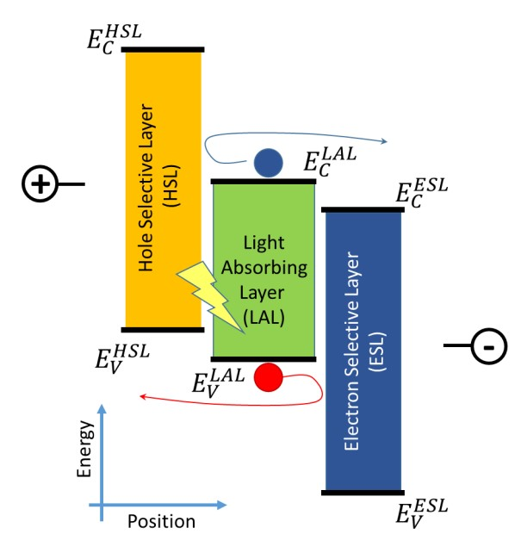
STATE OF THE ART
Electrolysis:
Hydroelectric energy
Current production technologies:
Oil
Gas
Algae
Wood
Electricity
Coal
Alcohols
Photovoltaic energy

Slide 6
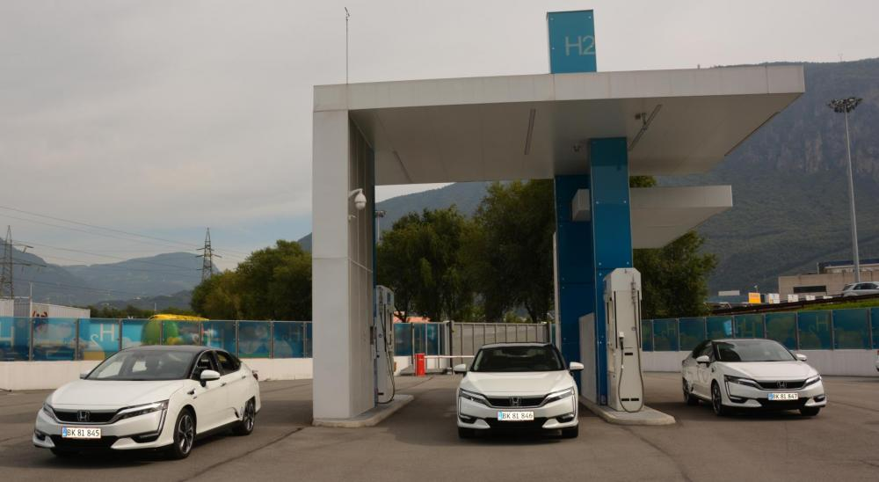
Example project - H2 SÜDTIROL
Green hydrogen produced locally;
Store surplus of energy from hydroelectric power plants in form of hydrogen;
Production up to 180 Nm³/hour;
Hydrogen can refill up to 15 urban buses (200/250 km range) or up to 700 cars.

Slide 7
Truck data
Scania G-series (ASKO) | CONS
WLTP Consumption [kg/km] | 0,07
Number of trucks | 10,00
Distance [km/day] | 500,00
Total H₂ required [kg/day] | 363,00
LHV H₂ [kWh/kg] | 33,31
Electric energy required [MWh] | 20,46
Location: Amazon logistics depot in Milano, Via Toffetti 108.

Slide 8
Case study
Hydropower + Transfer of electric energy to depot + Electrolyser in depot
Hydropower + Electrolyser on site + transport of H₂ to depot
Electricity from PV in Puglia + Electrolyser on site + Transport of H₂ to depot
Electricity from PV in Milano + Electrolyser on site
Notes:
Approfondire nel dettaglio parte

Slide 9
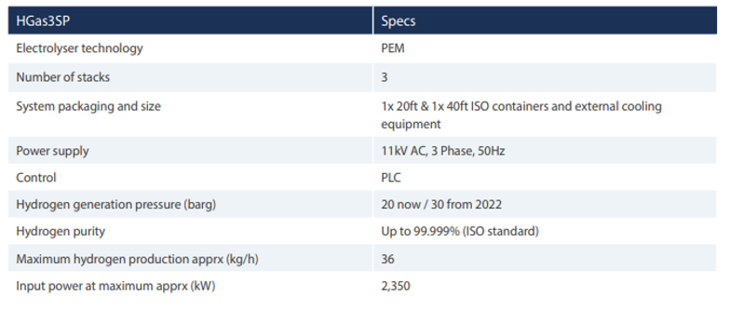
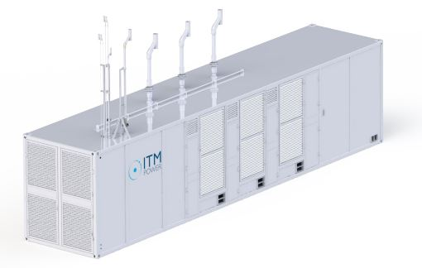
Chosen electrolyser – HGas3SP

Slide 10
hydroeletric powerplant - Crodo
Hydroelectric PP in Crodo
Efficient power [kW] | 52.800,00
Distance from depot [km] | 160,00
V_{Line} [V] | 200.000,00
I_{Line} [A] | 264,00
Power loss (HV systems) [%] | 2,00
Effective power [kW] | 51.744,00
Production of electricity;
Transmission of electricity via the grid;
Production of H₂ in the depot, electrolyser is an asset of the Logistics company;
Storage of H₂ in the depot.

Slide 11
Technical evaluation
PEM electrolyzer near the depot
Maximum H₂ production [kg/h] | 36,00
Hours to satisfy demand | 10,08
Working hours [h] | 11,00
Maximum power [kW] | 2.350,00
Production to satisfy demand in 11h [kg/h] | 33,00
Actual Power [kW] | 2.154,17
Energy (considering also compression) [MWh] | 23,72
The considered PEM electrolyser needs to work for 11 hours to satisfy the demand;
The power needed is less than the maximum.
The production will take place during the night, lower cost of electricity.

Slide 12
Economical evaluation
Costs for electricity
Electricity cost [€/kWh] | 0,11
Compression cost [kWh_{el}] | 29,04
Mean EU distribution cost [€/kWh] | 0,03
Tot cost of electricity [€/day] | 3.361,42
Costs for H₂ storage
Specific cost [€/kg] | 0,60
Specific cost [€/MJ] | 0,01
Total cost of storage [€/day] | 217,80
Cost of tank [€] | 945,78
Total emissions [kg_{CO2}/day] | 0,00
Investment cost
Mean investment cost PEM [€/kW] | 1.921,50
Investment cost [€] | 4.139.231,25
Mean life of plant [days] | 1.666,67
Daily investment cost [€/day] | 2.483,54
The considered solution needs to take into account the costs for the different steps;
For the computation of the daily cost, the cost of the storage tank has been divided by 365;
The investment cost is based on data taken from Piano Nazionale Mobilità Idrogeno (PNMI);
The final specific cost is reported in the table below.
Final specific cost
Total daily cost [€/day] | 6.065,35
Specific Cost [€/kg_{H2}] | 16,71
Specific cost [€/MJ_{H2}] | 0,14
Specific cost [€/MJ_{diesel}] | 0,03

Slide 13
hydroelectric powerplant - Trezzo sull’ adda
Hydroelectric PP in Trezzo Sull'Adda
Efficent power [kW] | 10.500,00
Mean produceable energy [kWh] | 65.000.000,00
V_{Line} [V] | 200.000,00
I_{Line} [A] | 52,50
Power loss (HV systems) [%] | 2,00
Effective power [kW] | 10.290,00
Hydrogen production in Trezzo sull’Adda;
Transport of hydrogen with Euro VI trucks;
Storage of hydrogen in the depot.

Slide 14
Technical evaluation
Regular Truck (Euro VI)
CO₂ emissions [g_{CO2}/km] | 94,00
Total distance [km/day] | 80,00
Total CO₂ emissions [g/day] | 7.520,00
Hydrogen transport with Euro VI trucks;
The transportable hydrogen (380 kg) is enough for one day;
The CO₂ emissions can be avoided with electric trucks.

Slide 15
Economical evaluation
Cost of green H₂ on the market
[€/kg] | 4,00
[€/MJ] | 0,03
The value chain of this solution leads to a price of 0.06 €/MJ_{H2};
The most impacting factors are transport and the purchase of green hydrogen;
The first one is not easily modifiable;
Sensitivity analysis on the price of green hydrogen;
Reduction of almost 80% in price, not viable in the short period.
Cost of transport by truck
[€/kg] | 3,00
Costs for H₂ storage
Cost of storage [€/kg] | 0,04
Cost of tank [€] | 945,78
Cost of storage [€/day] | 13,44
How much should H2 cost to be comparable with Diesel? | how much should H2 cost to be comparable with Diesel?
Cost of green H₂ [€/kg] | Specific cost [€/day] | Specific cost [€/MJ]
0,95 | 1.517,03 | 0,03
1,00 | 1.536,03 | 0,04
1,50 | 1.726,03 | 0,04
2,00 | 1.916,03 | 0,04
Total cost [€/day] | 2.676,03
Unitary cost [€/day*truck] | 267,64
Specific Cost [€/kg_{H2}] | 7,37
Specific cost [€/MJ_{H2}] | 0,06
Specific cost [€/MJ_{Diesel}] | 0,03

Slide 16
PV Puglia
Electricity production with solar panels, in the Solar Park near the city of Troia (FG);
Due to the different electricity production along the months, we need to store the surplus of energy:
Storage of electric energy;
Storage of hydrogen.
The hydrogen is produced on site with the same electrolyser we have seen before;
Transport of H₂ with a Euro VI truck to the depot in Milano.

Slide 17
Technical evaluation
Solar panel data
Energy required [MWh] | 23,72
Nominal power [W] | 375,00
Surface [m2] | 1,84
Weight [kg] | 18,50
Efficiency of the panel [%] | 20,10
Cost oh the panel [€/panel] | 811,88
The only direct source of CO₂ is the transportation of hydrogen;
Hydrogen transportation to the depot (783 km) emits a total amount of 53,73 tons of CO₂ each year;
The surplus of hydrogen is higher than the amount stored, so it can be sold.
Irradiation coefficient per month
Sizing PV plant
Installed PV power [kW] | 28.755,67
Oversized PV power [kW] | 31.631,24
Number of panels | 84.350,00
Total surface [m²] | 155.394,29
Battery Capacity [kWh] | 249.995,79
Electricity surplus [kWh] | 1.072.952,32
H₂ surplus [kg] | 24.860,53

Slide 18
Economical evaluation
Cost of the facilities:
Solar panel;
Storage system;
Cost of transportation;
Revenues from hydrogen.
Due to the high cost of batteries (2 million €), we decided to directly store the hydrogen (10 thousand €).
Specific cost analysis
Cost of transportation | 397.485,00 €
Cost of compression | 5.405,64 €
Cost of storage | 5.532,37 €
Cost of PV plant | 3.424.103,90 €
Total daily cost | 12.835,56 €
Hydrogen revenues | 78.061,29 €
Specific cost [€/kg_{H2}] | 35,36
Specific cost [€/MJ_{H2}] | 0,29

Slide 19
PV Milano
Same reasonment made for the previous case, but with some differences:
No need for transportation, so this solution is the only one with no CO₂ direct emissions;
Lower irradiance factor, due to the different geographical position:
Higher storage required;
Lower revenues from sold hydrogen.

Slide 20
Technical evaluation
Solar panel data
Energy required [MWh] | 23,72
Nominal power [W] | 375,00
Surface [m2] | 1,84
Weight [kg] | 18,50
Efficiency of the panel [%] | 20,10
Cost oh the panel [€/panel] | 811,88
No direct source of CO₂;
No hydrogen transportation;
The surplus of hydrogen is higher than the amount stored, so it can be sold.
Irradiation coefficient per month
Sizing PV plant
Installed PV power [kW] | 46.664,74
Oversized PV power [kW] | 51.331,22
Number of panels | 136.884,00
Total surface [m²] | 773.561,96
Battery Capacity [kWh] | 252.175,37
Electricity surplus [kWh] | 702.401,95
H₂ surplus [kg] | 24.860,53

Slide 21
Economical evaluation
Cost of the facilities:
Solar panel (higher);
Storage system (higher);
Revenues from hydrogen (lower).
Also in this case we store hydrogen, and the convenience is greater that before:
6,3 million € for batteries;
40 thousand € for hydrogen.
Specific cost analysis
Cost of transportation | 0,00 €
Cost of compression | 19.501,60 €
Cost of storage | 19.958,79 €
Cost of PV plant | 5.556.669,10 €
Total daily cost | 17.894,32 €
Hydrogen revenues | 57.863,61 €
Specific cost [€/kg_{H2}] | 49,30
Specific cost [€/MJ_{H2}] | 0,41

Slide 22
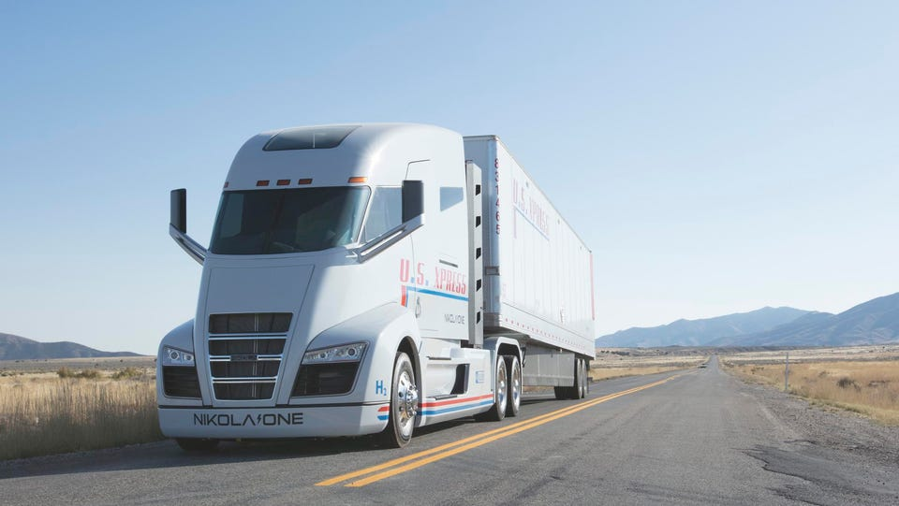
CONCLUSIONS
Four different case studies using fuel cell truck (in picture above) have been analyzed and compared to a standard technology solution (diesel ICE).

Slide 23
Comparison of costs
Hydroelectric solutions cheaper than PV plant solution.
Most impacting costs:
Solution 1: electrolyzer;
Solution 2: hydrogen purchase;
Solution 3 & 4: solar panels.
 | Unitary cost [€/MJ] | Unitary cost [€/kg_{H2}] | Total cost [€]
Crodo | 0,14 | 17,72 | 2.348.244,67
T. S. Adda | 0,06 | 8,39 | 1.111.140,57
PV puglia | 0,30 | 36,57 | 4.845.392,65
PV milano | 0,41 | 50,46 | 6.685.106,18
Diesel | 0,03 | - | 1.019.416,67
As expected Diesel case is the most convenient

Slide 24
COMPARISON OF EMISSIONS
Considered also emissions by actual hydroelectric energy consumers forced to turn to the national grid → Milano solution is the only 100% green case
All the solution proposed manage to reduce substantially the emissions of CO2 (worst reduction above 98%).
 | CO2 emissions [kg] | CO2 reduction [%]
Crodo | 2.390.043,74 | 99,13
T. S. Adda | 5.134.843,74 | 98,13
PV puglia | 53.729,46 | 99,98
PV milano | 0,00 | 100,00
Diesel | 273.969.000,00 | -

Slide 25
Final remarks
In the solution 1, 3 and 4 we would fill the economicity gap with the diesel solution, cutting 100% of the most impacting voice of cost → NOT FEASIBLE
Necessity of acting on the whole production and storage system both technically and economically;
In the short term, we still expect a better convenience for traditional diesel sources.
No single optimal renewable solution for all the application

Slide 26
(H₂) TANK YOU FOR YOUR ATTENTION
Energy and Emissions in Transportation System – Group 3

